Slide 1


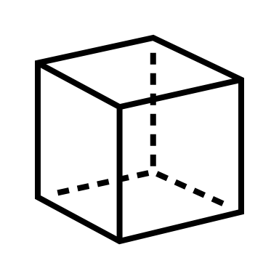







IDP: First Presentation
Team 4 (L104) aka “Porous a drink”
Jan Derlatka
Jenny Hardwick
Noah Barker
Maya Roy Prabhakaran
Lucca Pereira Martins
Szymon Piatek

Slide 2


The Team
Software
Electronics
Mechanics
PM
Jan
Noah
Maya
Lucca
Szymon
Jenny

Slide 3
Project Management
Gantt chart :
1. All team members aware of important deadlines, milestones and key timeframes of the project.
2. Will be updated daily to help ensure focus shifts with the most critical tasks to complete.

Slide 4
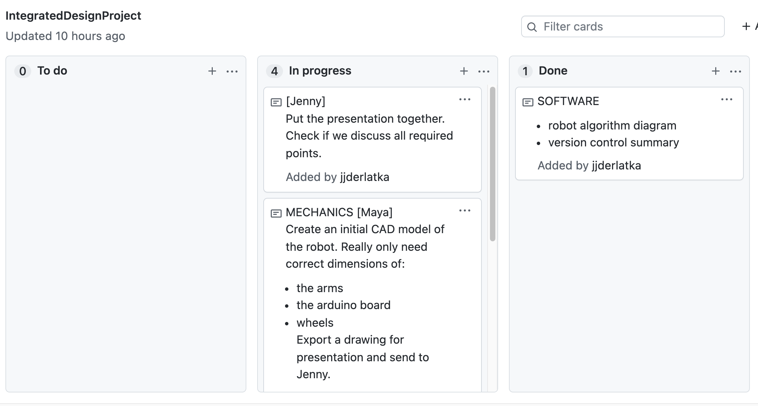

Project Management
GitHub Repository
One single location to share and store all files associated with the project including but not limited to:
Code
CAD parts, assemblies and drawings
Sketches, idea sharing while not together in-person
Electrical schematics and simulations
Gantt chart
Presentations, report diagrams
Version control for all teams, not just software – will allow maximum coordination and communication and avoid two people doing the same work.
Tasks set and assigned to team members
Easy to see what needs to be done and who needs to do it
We also have a WhatsApp group chat!

Slide 5
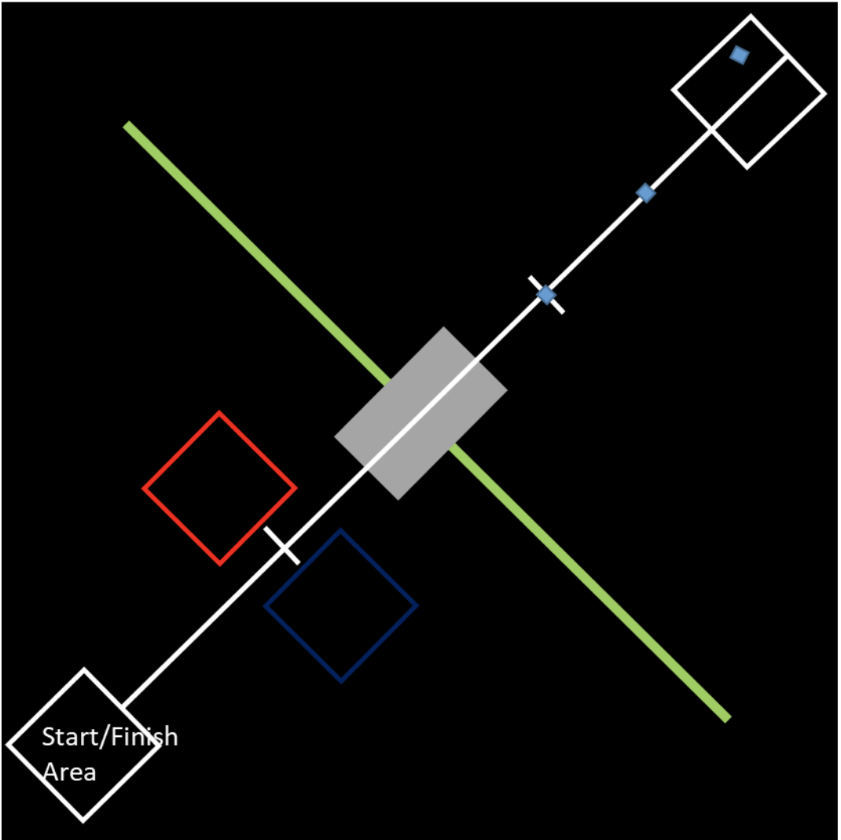


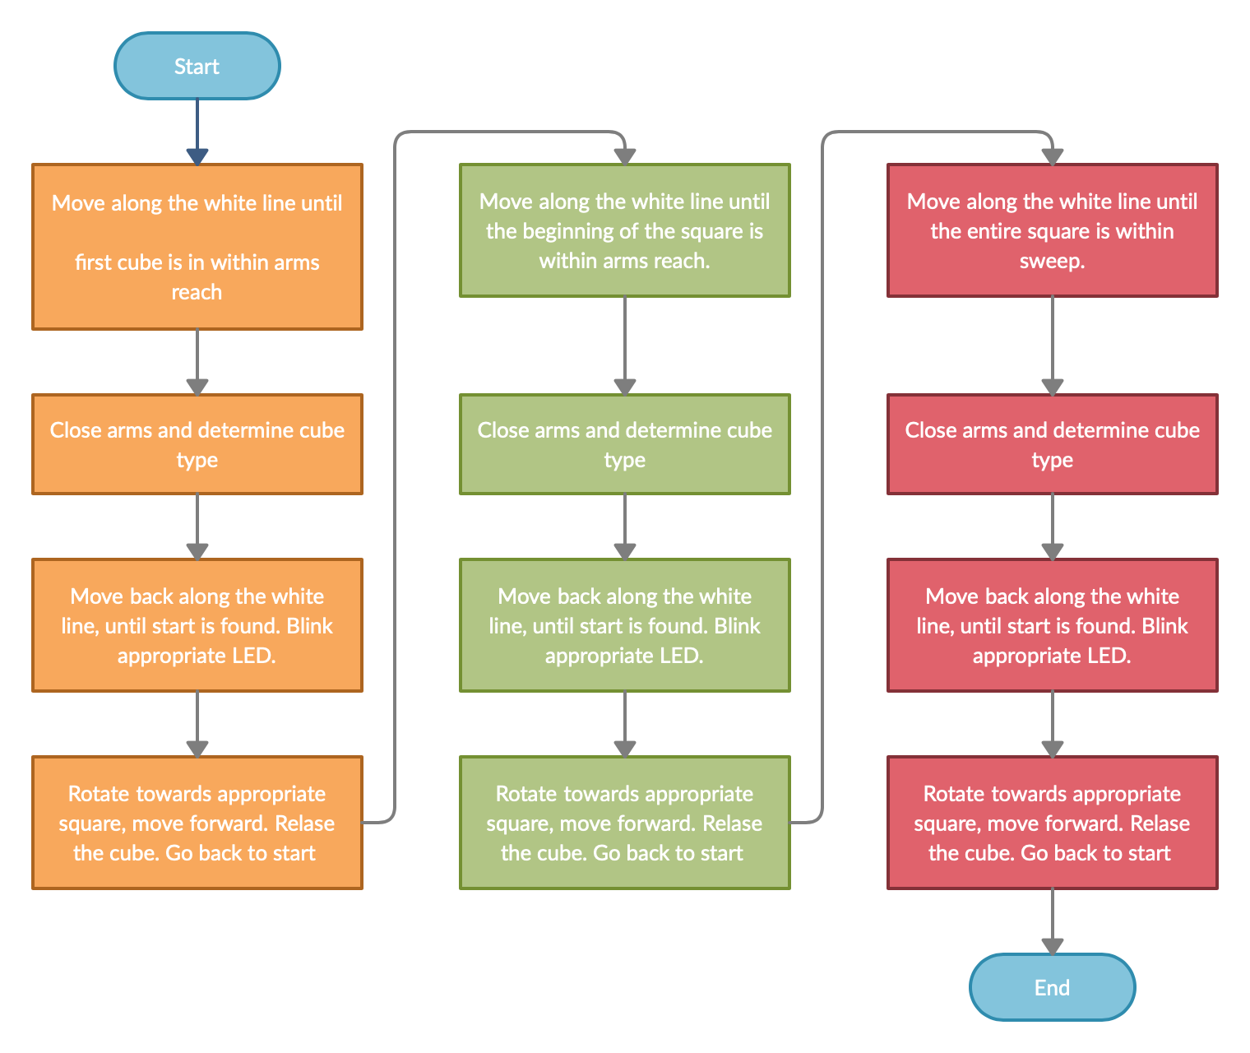

Our approach

Slide 6
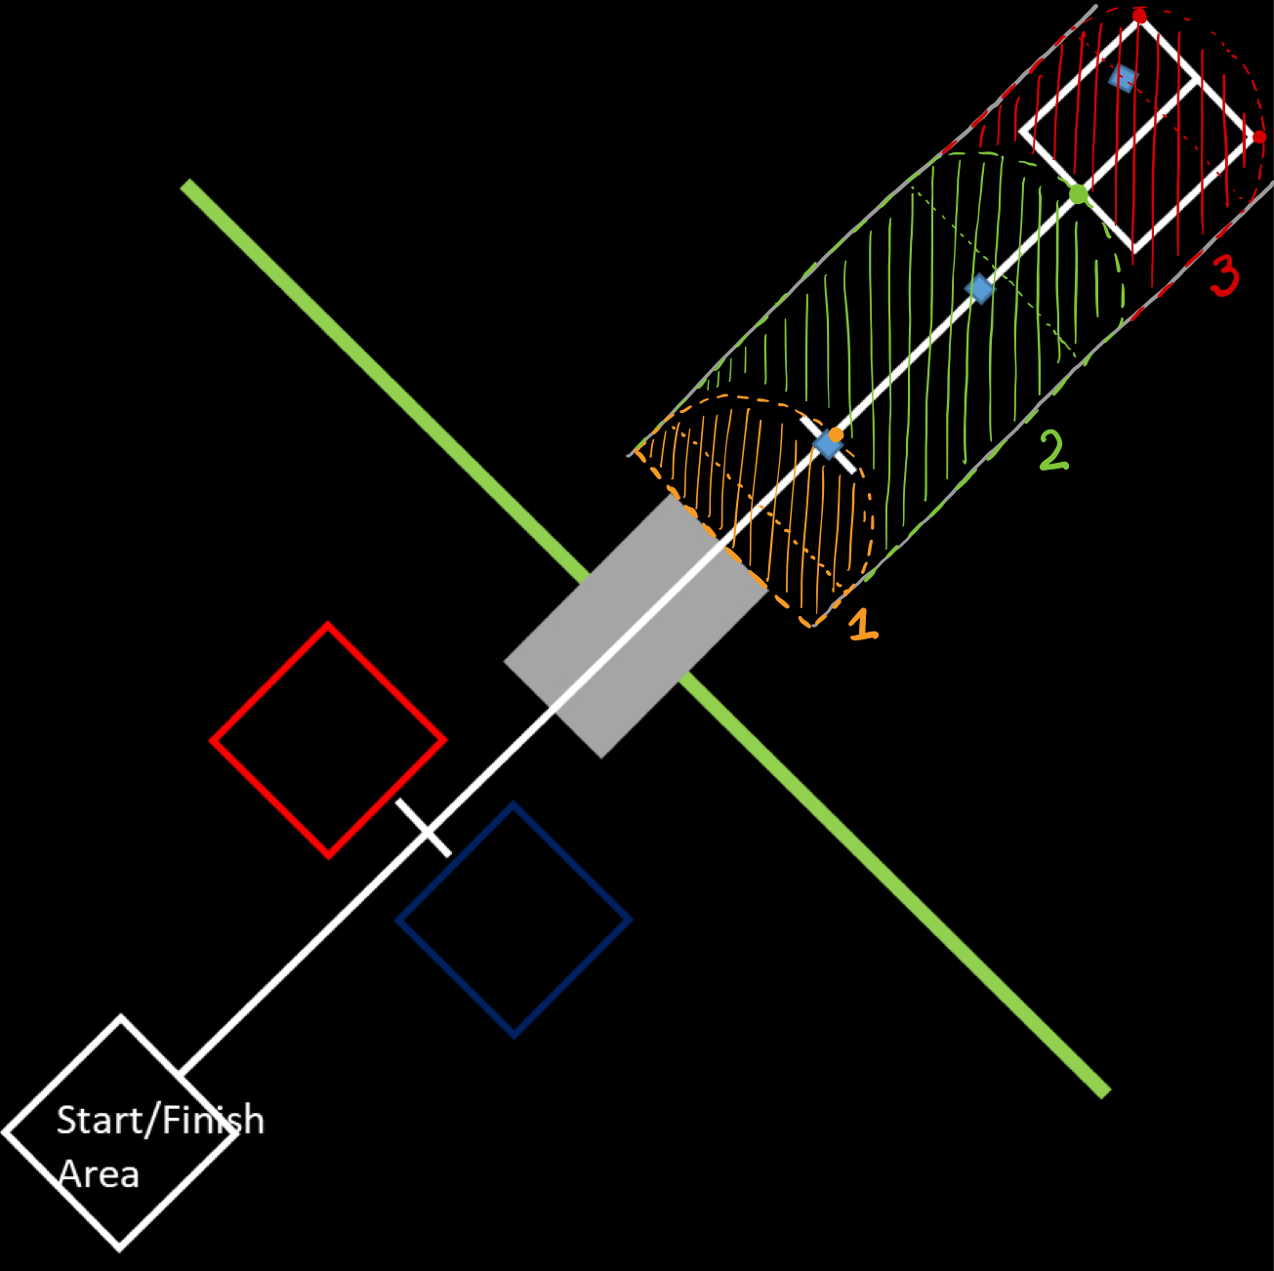
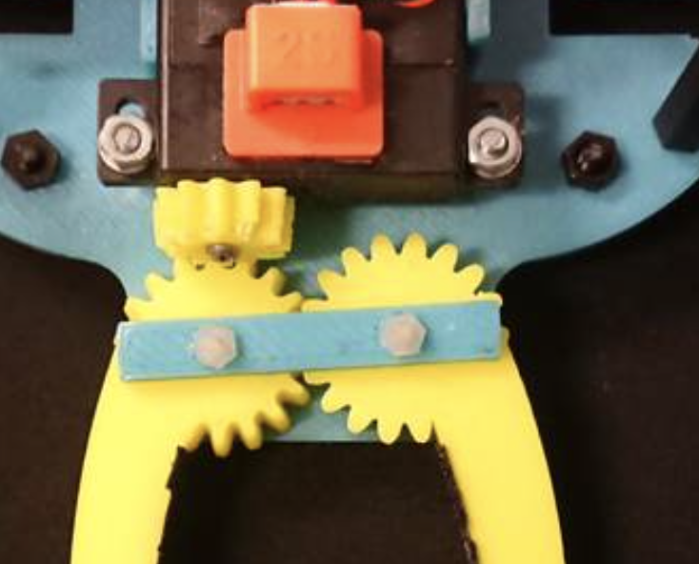
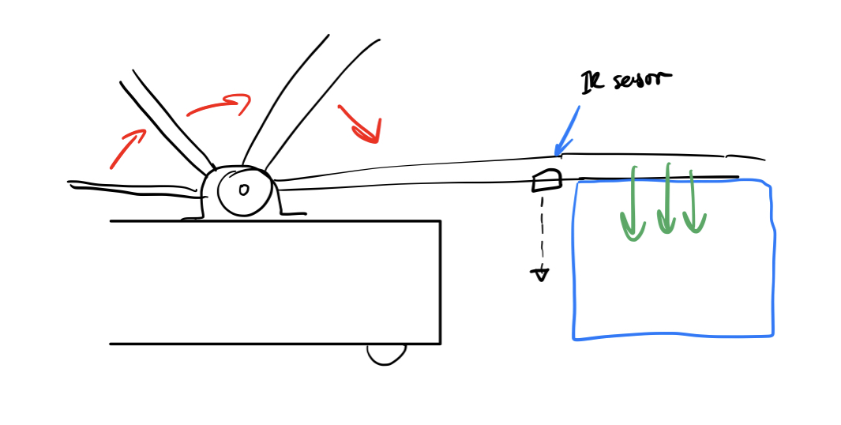
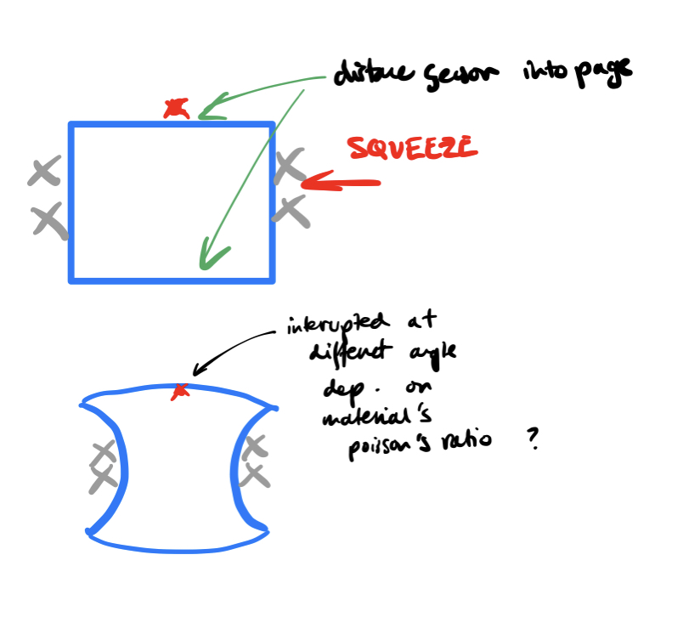
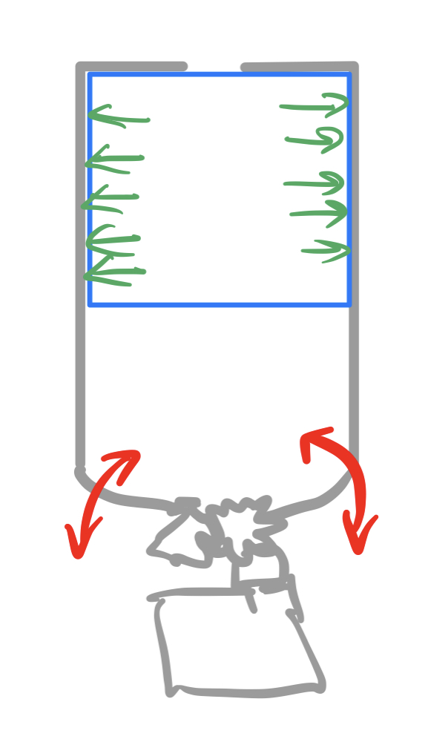
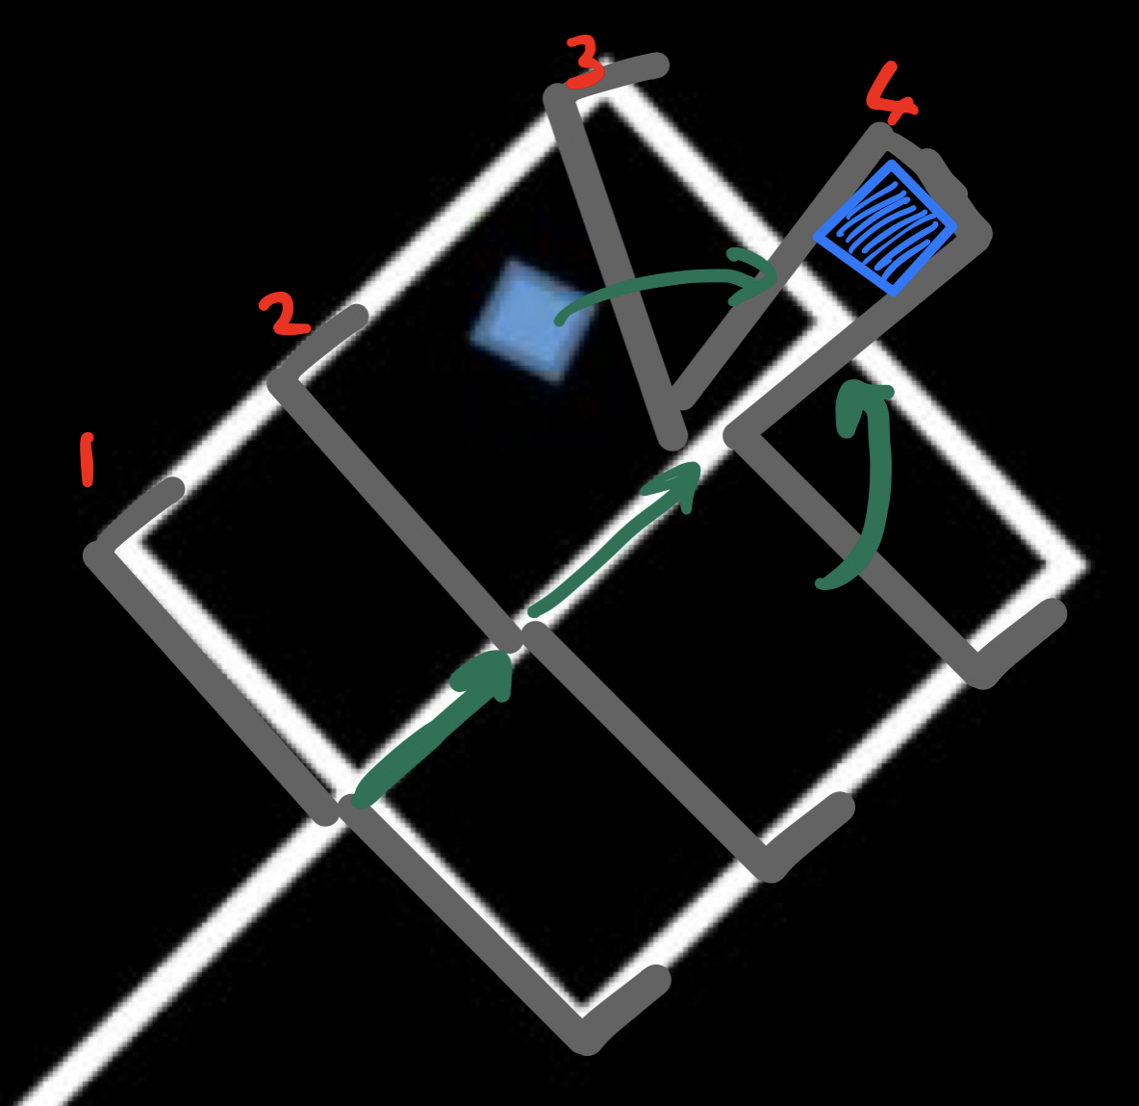
How will we capture and transport the cube?
How will we know which cube we have picked up?
Various options available: leading currently is option 3
1.
Only one servo required
3.
2.
4. Ultrasound? Light?

Slide 7
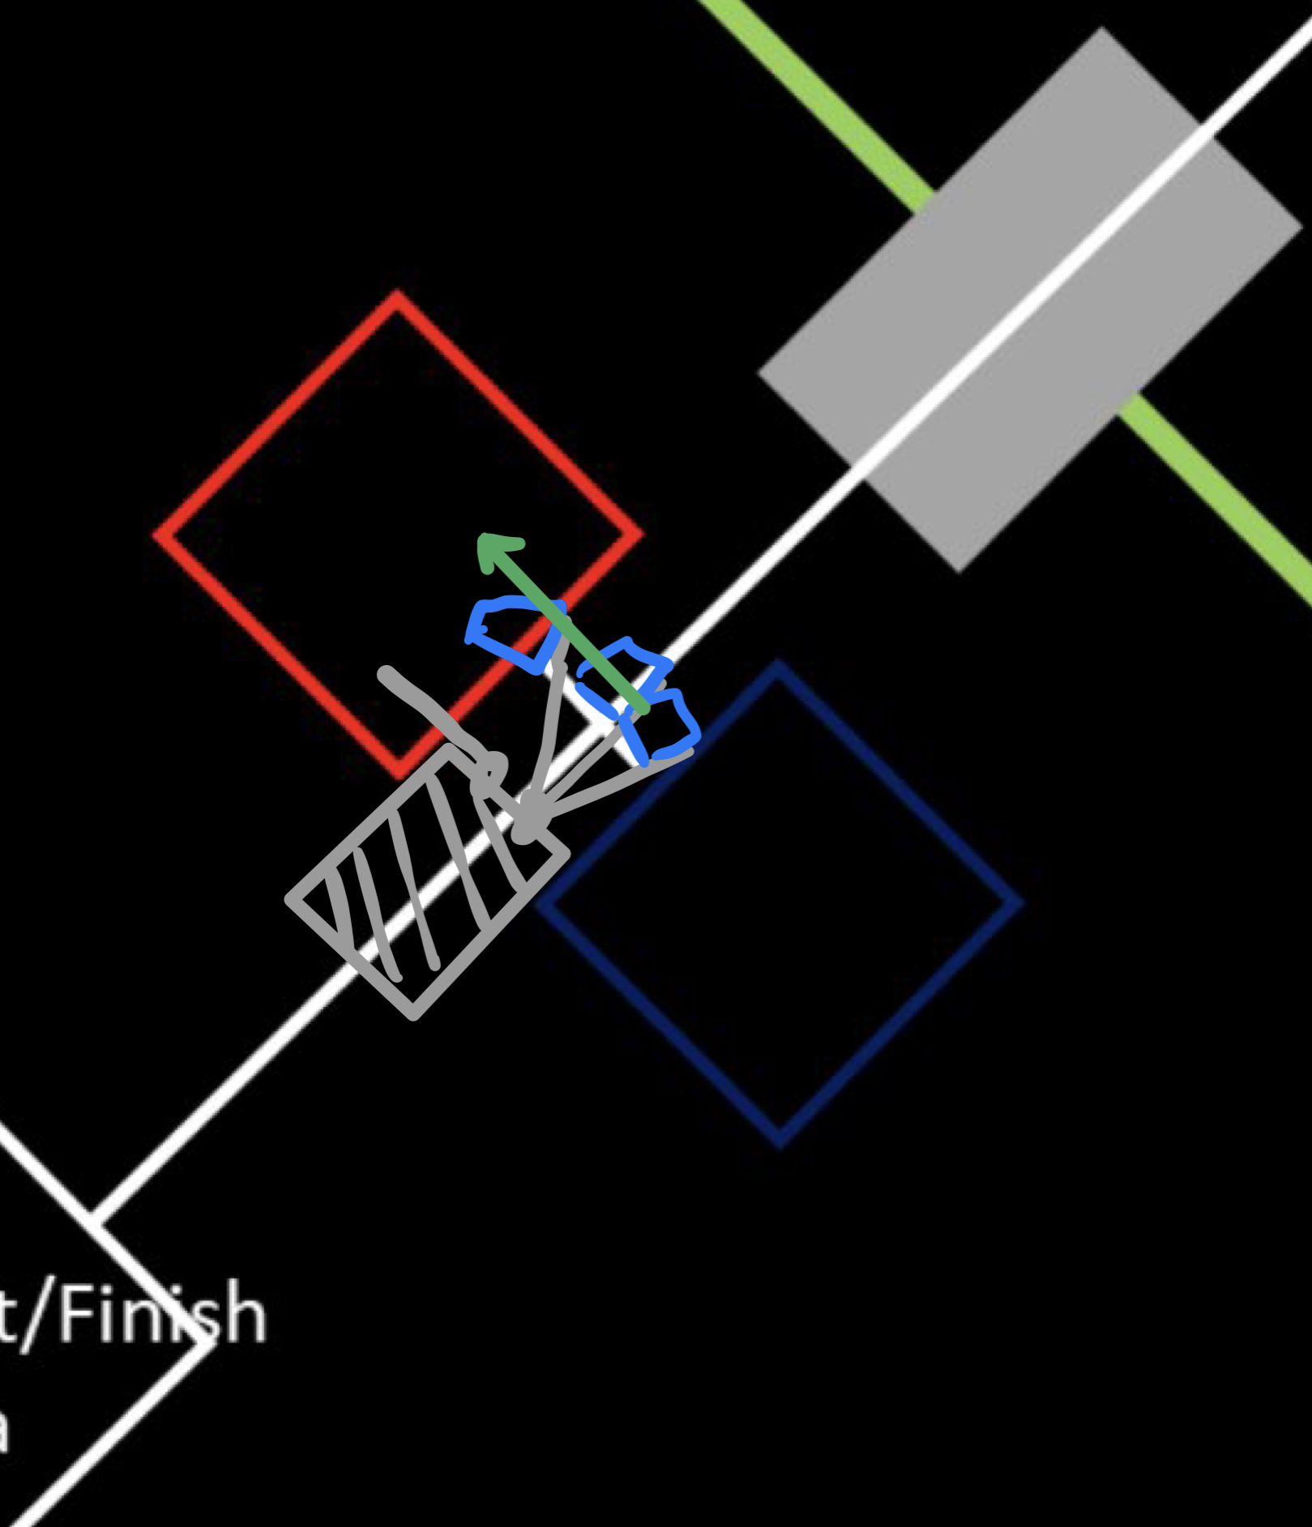
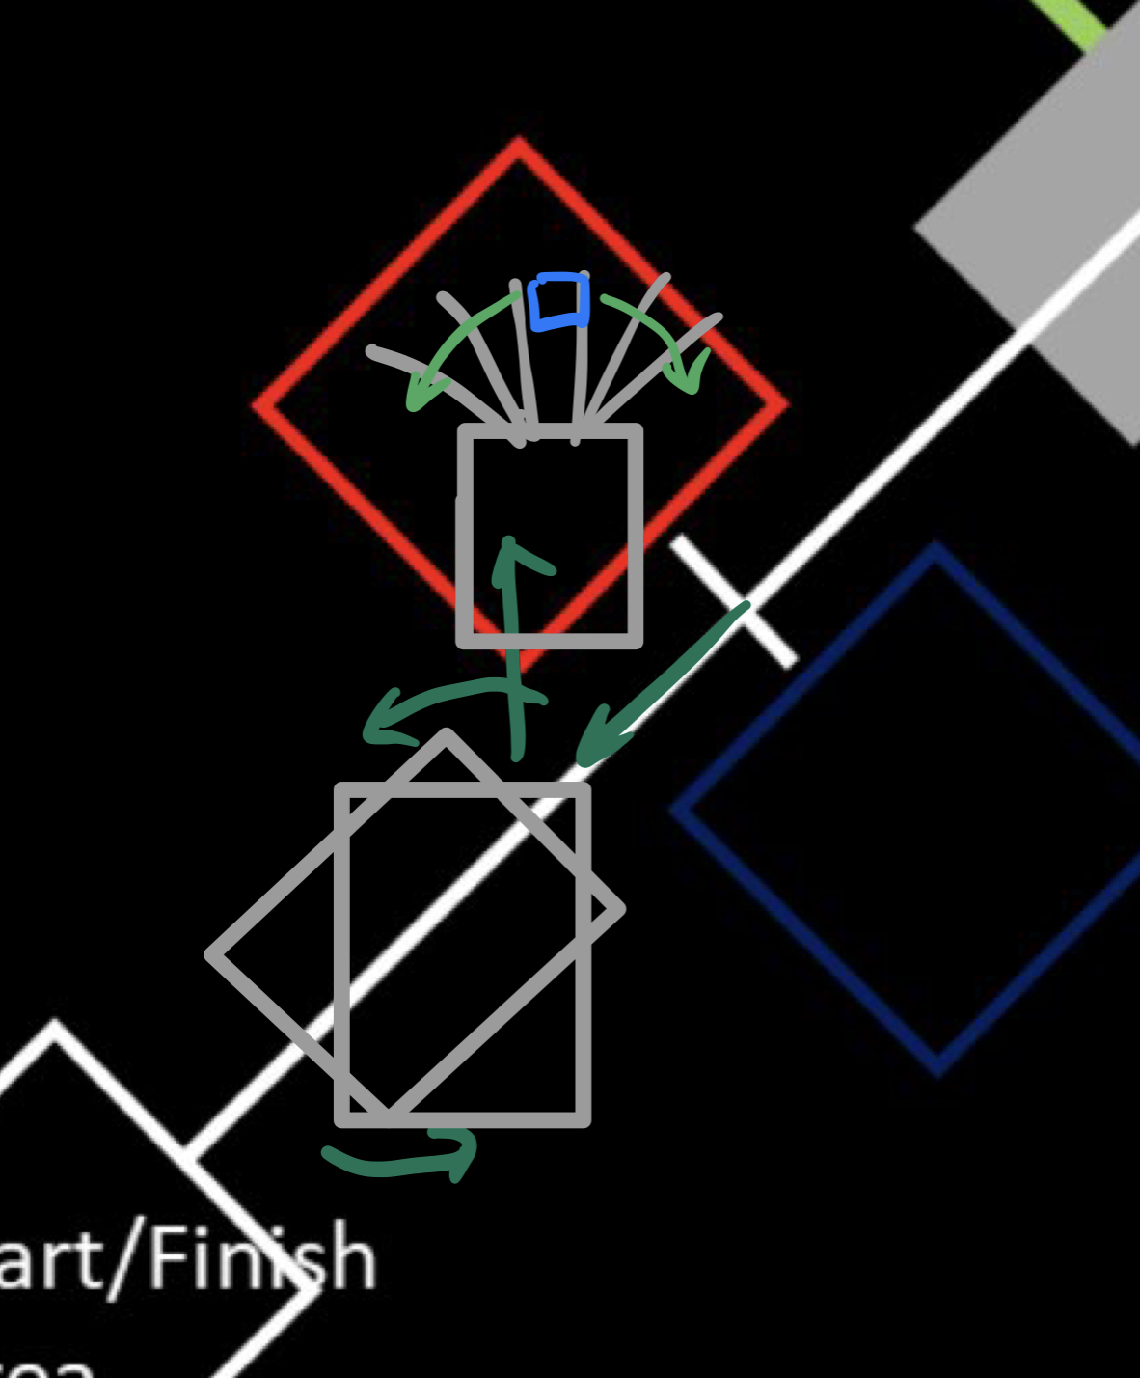
How will we place the cubes in the correct box?
Why this design? How do we know it is going to work?
Option 1:
Option 2:
Simple – only one servo required to capture and drag the cube
Requires no mechanism for “finding” the final cube
The car never has to leave the line (if Option 1 is chosen for cube drop-off)
The car never needs to rotate, only move forwards and backwards
Testing and calculations

Slide 8
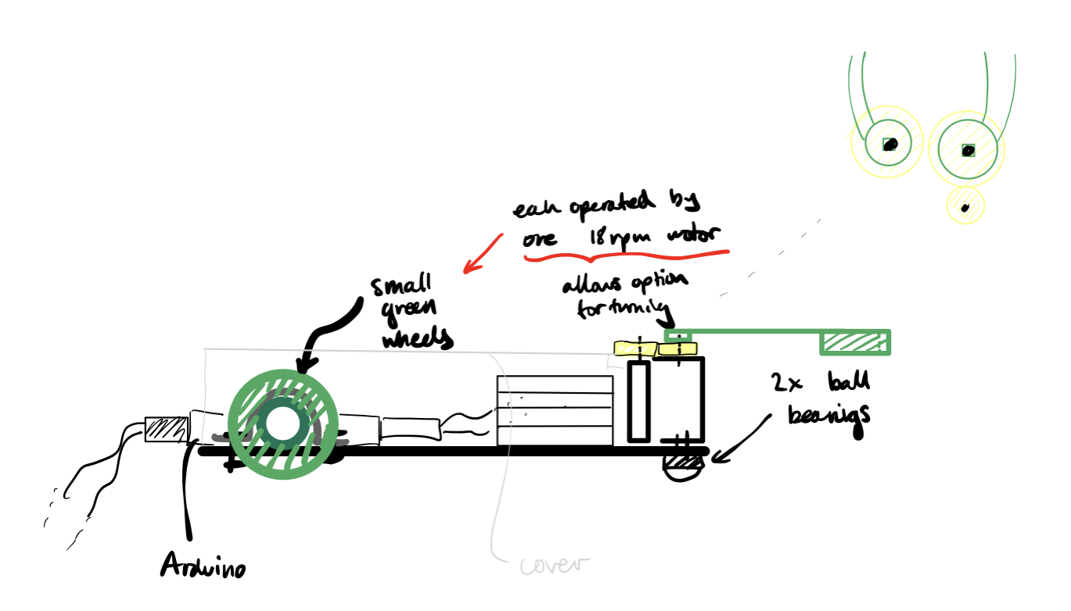
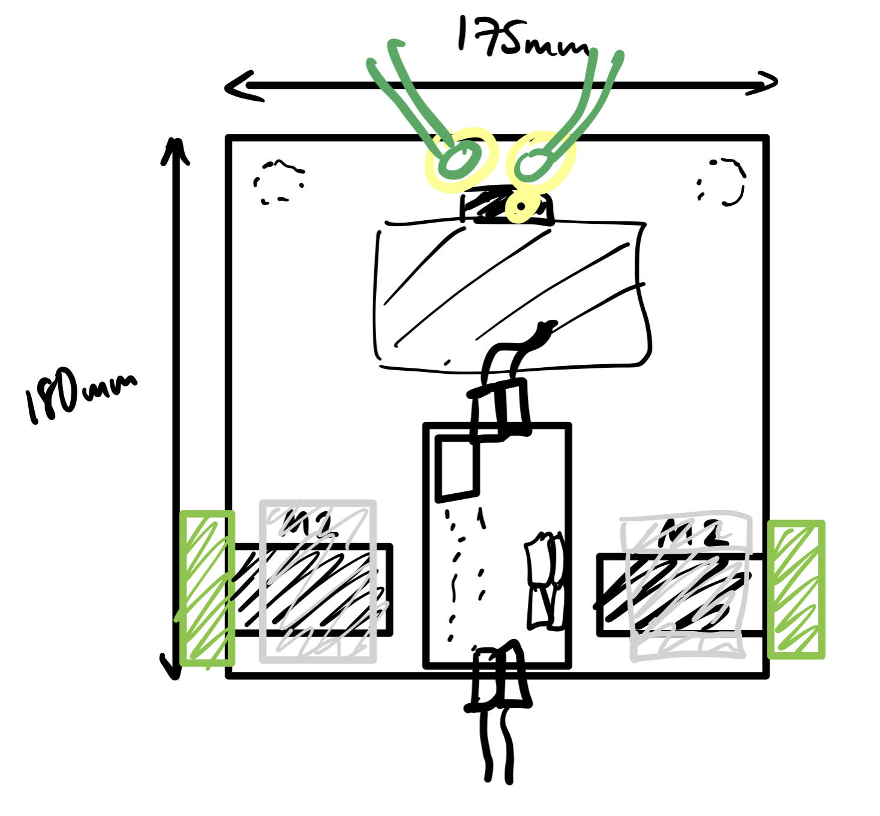
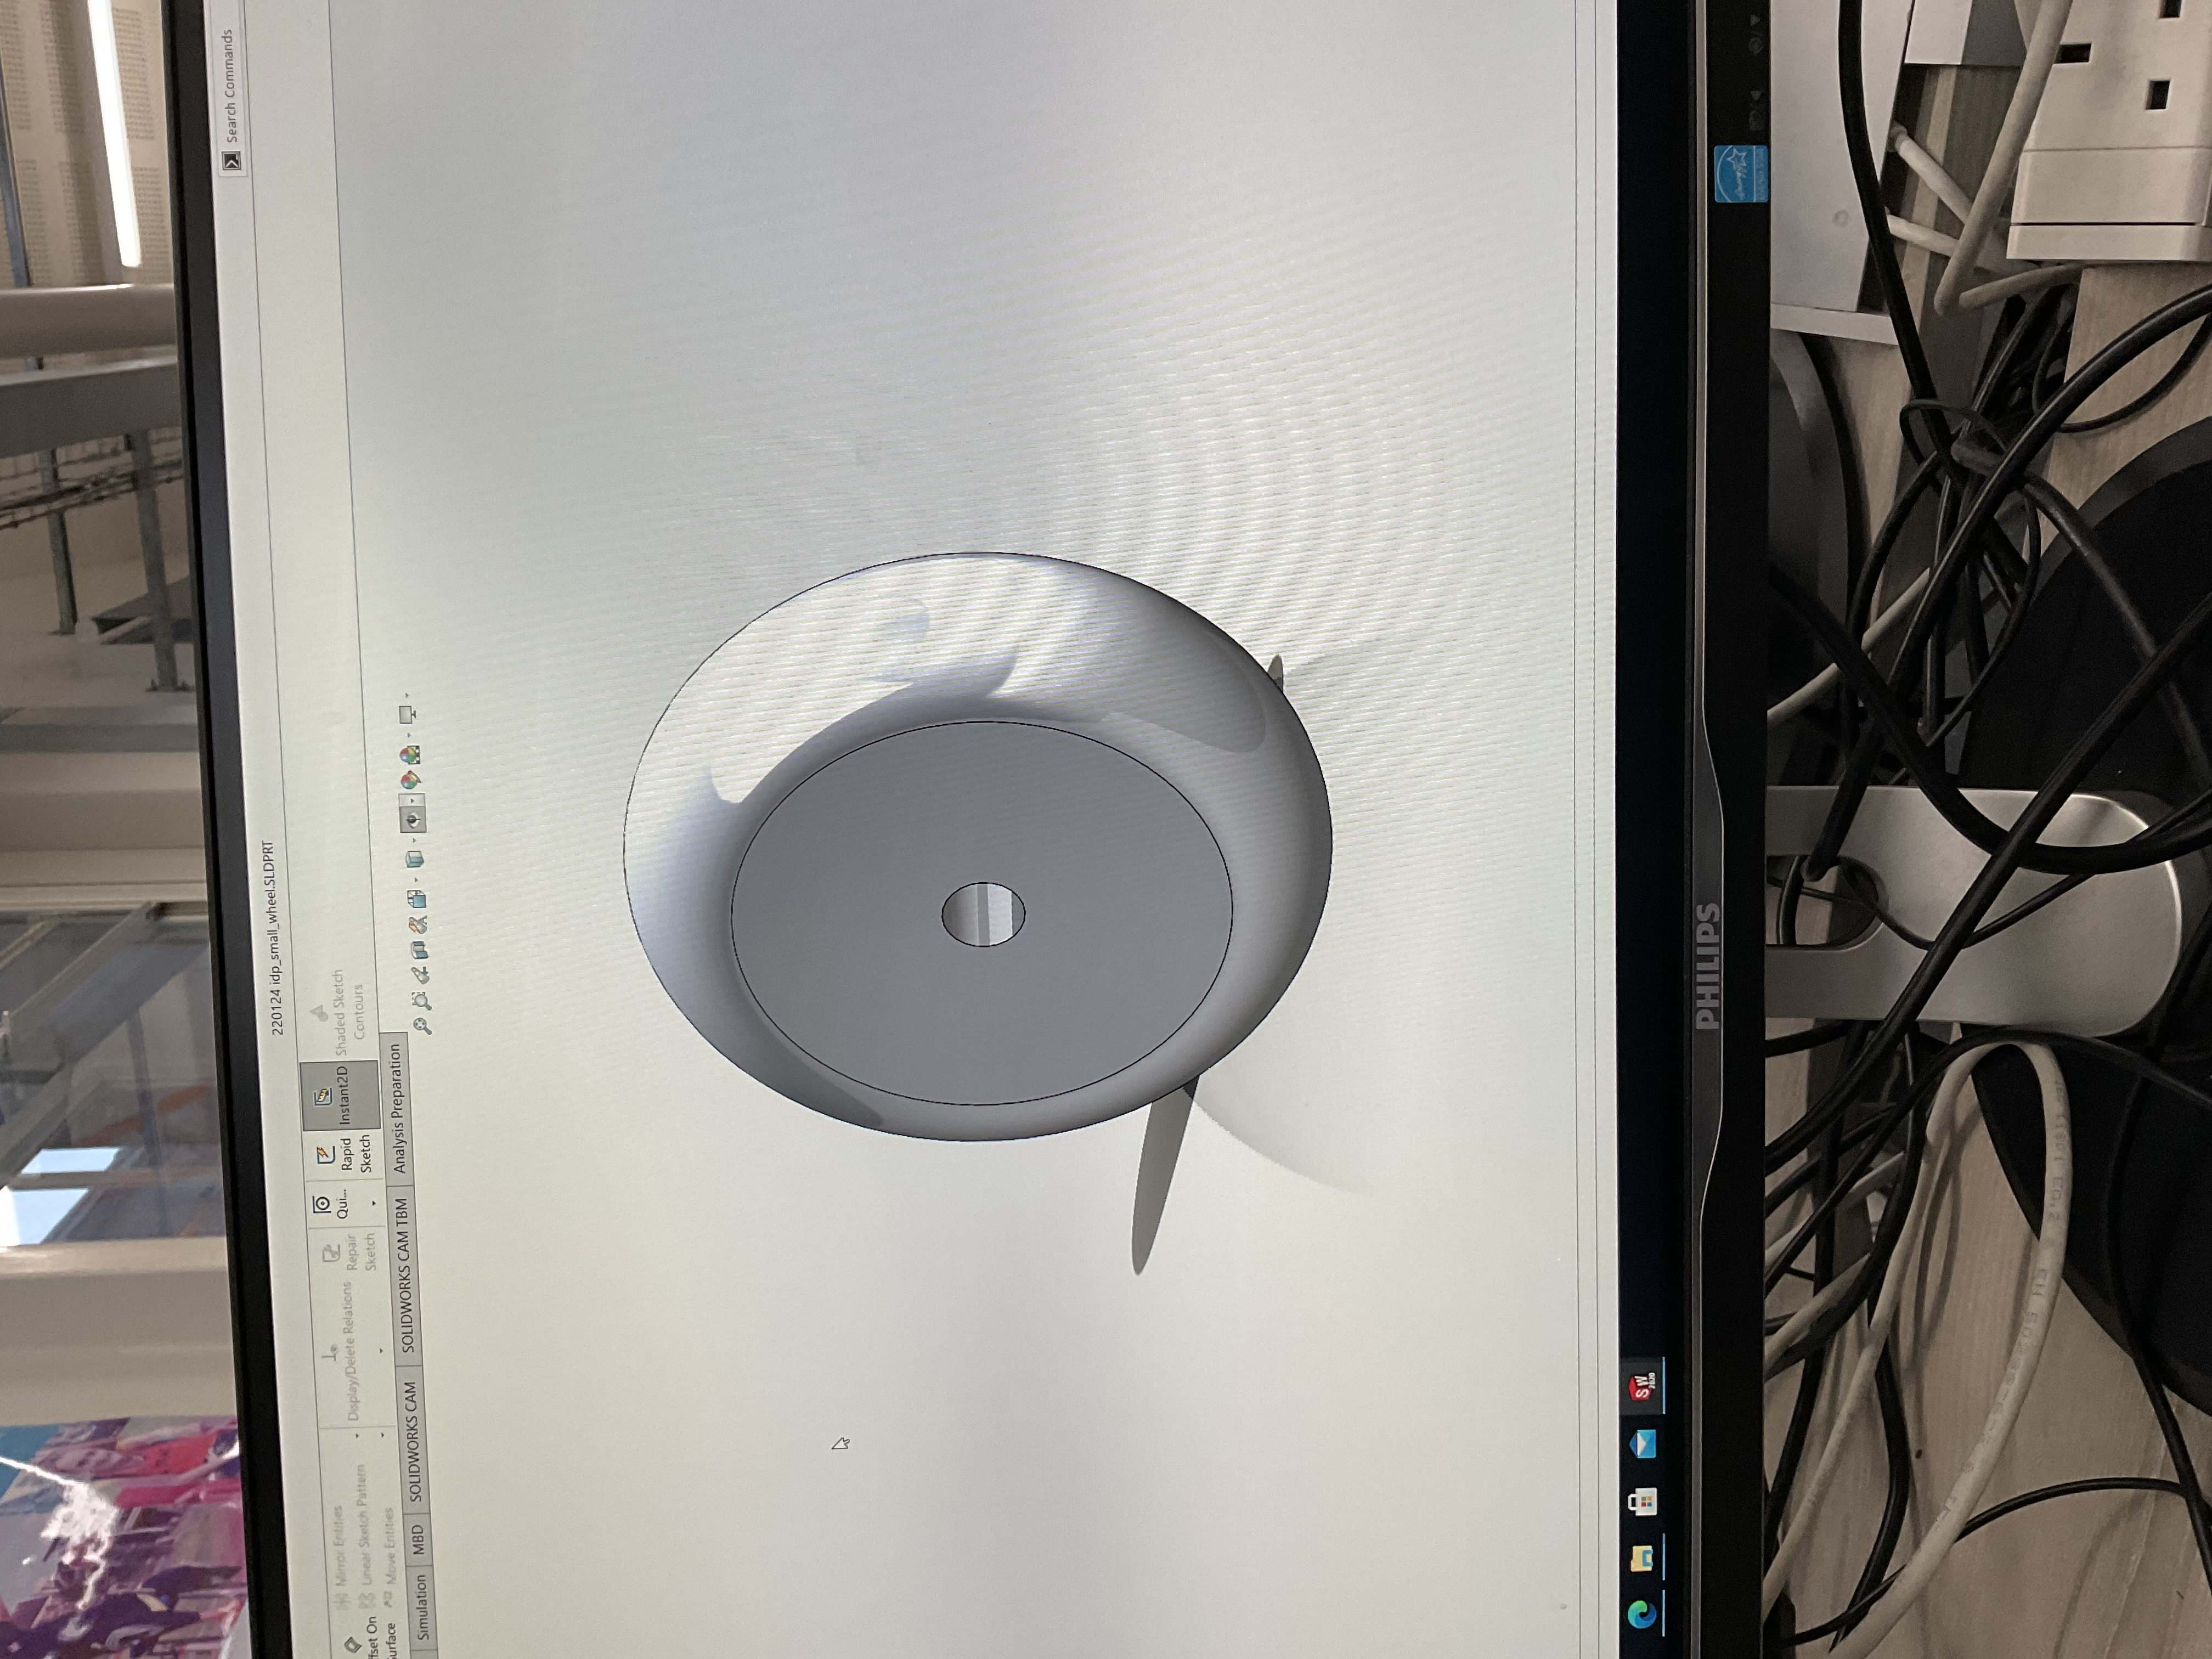
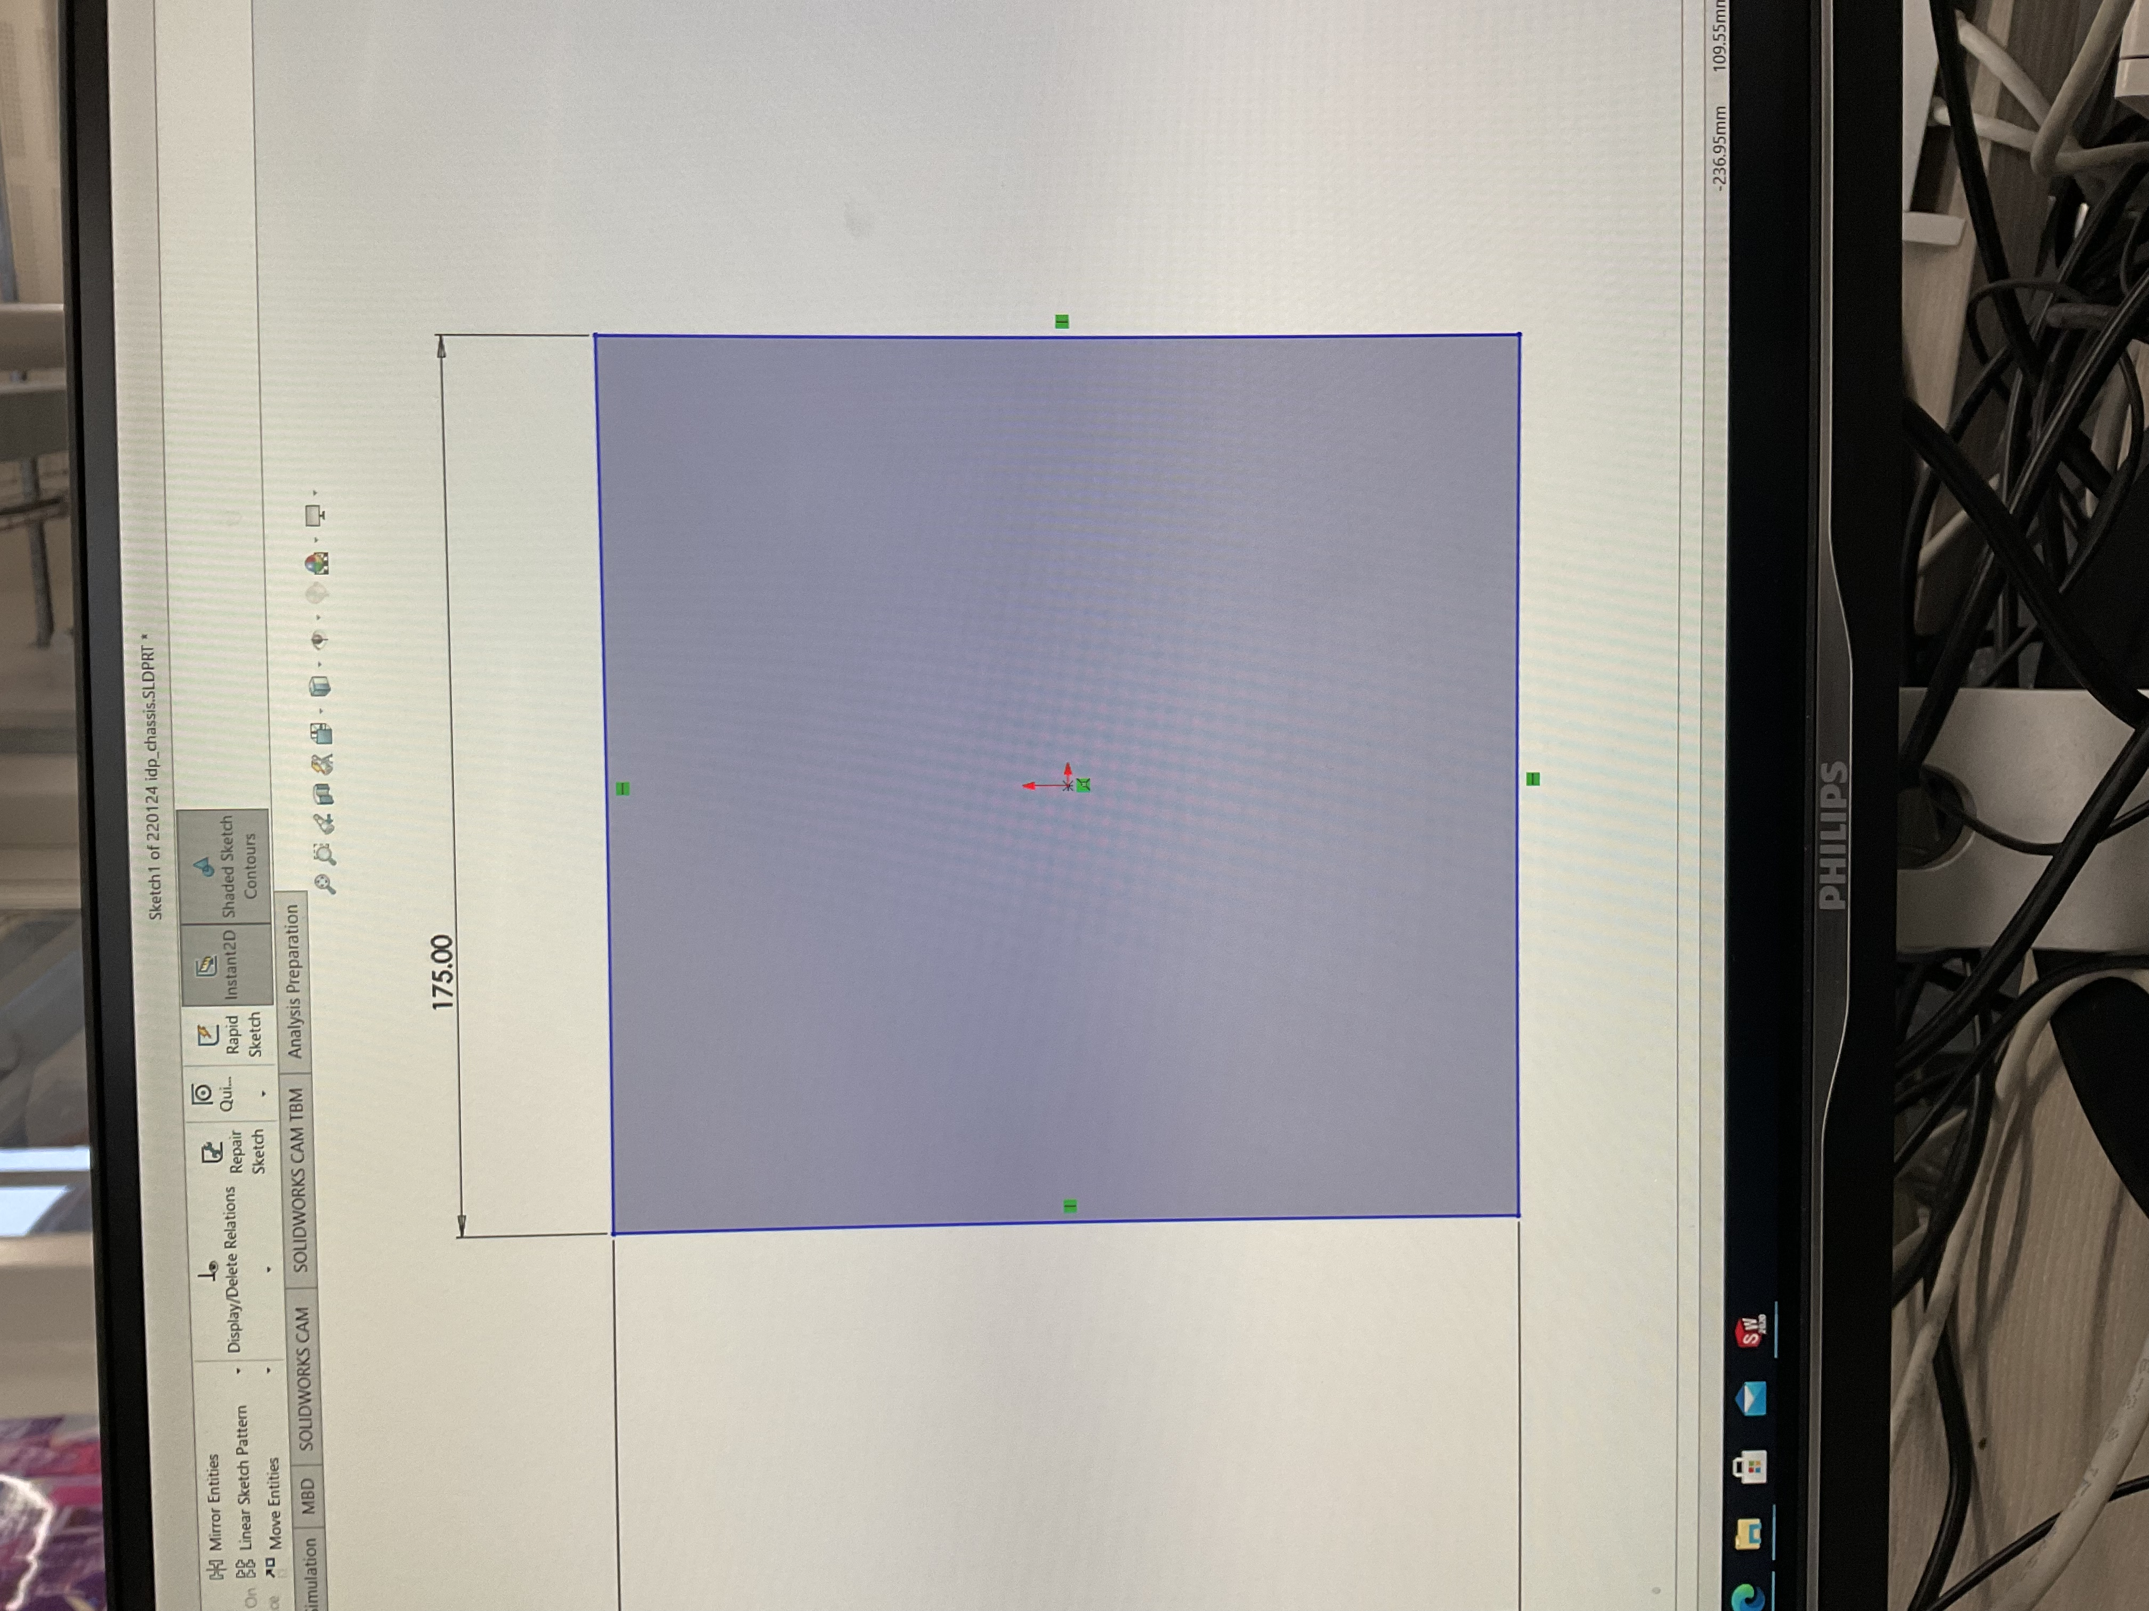
The robot
MDF chassis + shelving
Aluminium motor mounts
3D-printed pincer arms
3D-printed servo mount

Slide 9
What will be our biggest challenges?
Measuring the foam type
Keeping the foam within the pincers during transport over the ramp
Losing track of the white line
Failing to cross the ramp
Allowing enough time for integration

